Slide 1

PRINCIPAL COMPONET ANALYSIS (PCA) Christian Rodriguez Esau May Ceh Amaury Castellanos Monica Hernandez
Subject: Machine Learning
Topics:
Definition of PCA
How to apply
Eigenvector and eigenvalues
Covariance Matrix
Find the PCA
Example

Slide 2

"How can we extract essential information and reduce the complexity of our data in an increasingly information-rich world with complex datasets?"

Slide 3
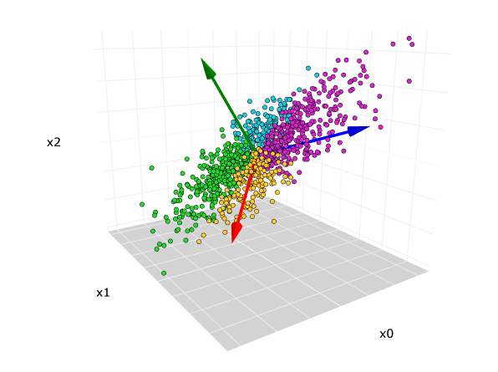
Definition
Is a statistic method that is used to reduce the dimensionality of a dataset. This technique help us to simplify a dataset and chose the smaller number of predictors to predict a variable, objective or understand in a better way a BDD
https://www.hiberus.com/crecemos-contigo/analisis-de-componentes-principales/

Slide 4
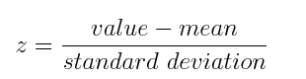
How apply PCA
Step 1: Standardization
The aim of this step is to standardize the range of the continuous initial variables so that each one of them contributes equally to the analysis.
For example, a variable that ranges between 0 and 100 will dominate over a variable that ranges between 0 and 1), which will lead to biased results. So, transforming the data to comparable scales can prevent this problem.

Slide 5
How apply PCA
Step 2: Covariance matrix computation
The first step is to calculate the covariance matrix, that show the relationship between the different characteristics and how they are different together.
Eigenvector represent the higher variability direction of the data and Eigenvalues indicates how much variability is associated with each eigenvector.
Sort the eigenvectors and eigenvalues.
Step 3: Select the principal components
Step 4: Data projection
https://builtin.com/data-science/step-step-explanation-principal-component-analysis

Slide 6

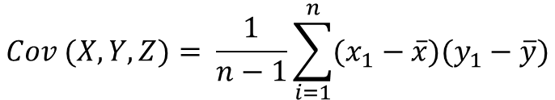
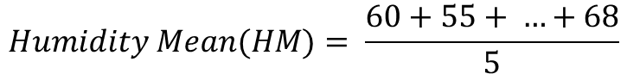
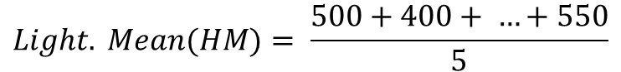
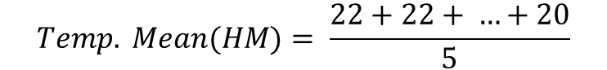
So… What are the Eigenvectors and Eigenvalues?
1. We need to calculate the mean for each data set: Temperature, Light Level…
First we need to understand how calcultate the covariance matrix:
Lecture | Humidity (x) | Temperature(y) | Light Level (z)
1 | 60 | 25 | 500
2 | 55 | 22 | 400
3 | 65 | 28 | 600
4 | 58 | 23 | 450
5 | 68 | 20 | 550
$$Humidity Mean(HM)= \frac{60+55+ …+68}{5}$$
$$Temp. Mean(HM)= \frac{22+22+ …+20}{5}$$
$$Light. Mean(HM)= \frac{500+400+ …+550}{5}$$
2. Calculate the covariance matrix
$$Cov (X, Y, Z)= \frac{1}{n−1}\sum_{i=1}^{n}{(x_{1}−\overline{x})(y_{1}−\overline{y}})$$
$$Cov \left(X, Y, Z …\right)= \frac{\left(60 −HM\right)\left(25−TM\right)\left(500−LM\right)+(55−HM)(22−TM)(400−LM)}{n(number of observations)−1})$$

Slide 7
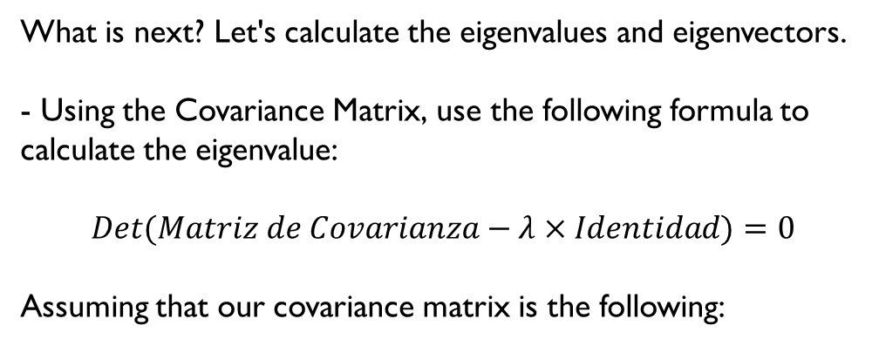


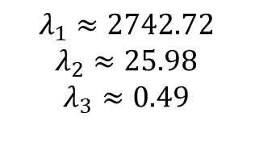
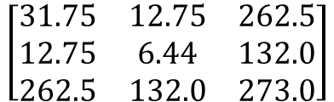
Covariance Matrix
$$\left|\begin{matrix}Cov(Hum, Hum) & Cov(Hum, Temp) & Cov(Hum, Light) \\ Cov(Temp, Hum) & Cov(Temp, Temp) & Cov(Temp, Light) \\ Cov(Light, Hum) & Cov(Light, Temp) & Cov(Light, Light)\end{matrix}\right|$$
The results of the equation are the following:
What is next? Let's calculate the eigenvalues and eigenvectors.
- Using the Covariance Matrix, use the following formula to calculate the eigenvalue:
$$Det(Matriz de Covarianza−λ×Identidad)=0$$
Assuming that our covariance matrix is the following:
$$λ_{1}≈2742.72$$
$$λ_{2}≈25.98$$
$$λ_{3}≈0.49$$
$$\left[\begin{matrix}31.75 & 12.75 & 262.5 \\ 12.75 & 6.44 & 132.0 \\ 262.5 & 132.0 & 273.0\end{matrix}\right]$$

Slide 8
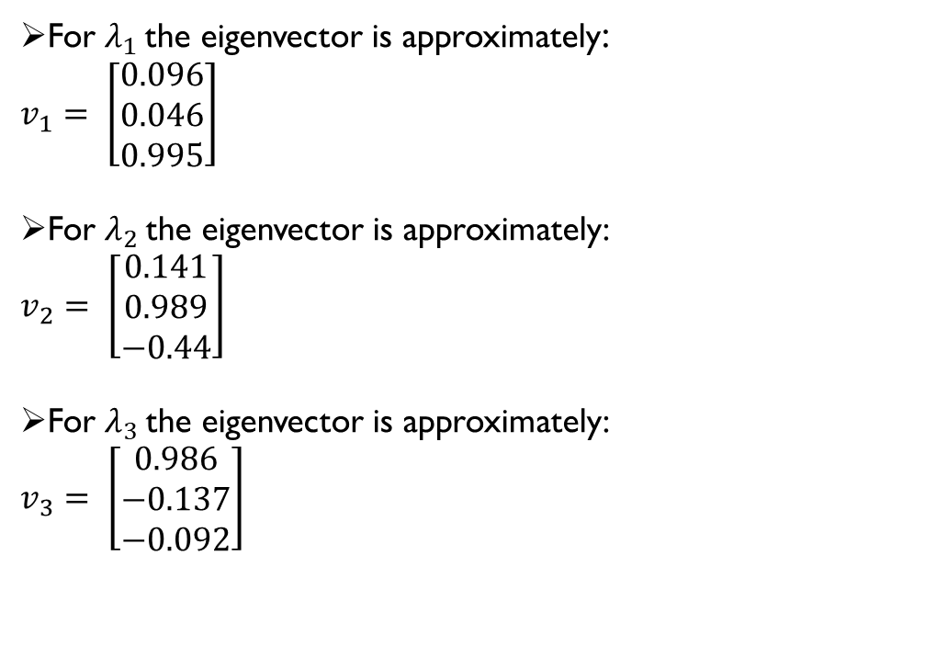
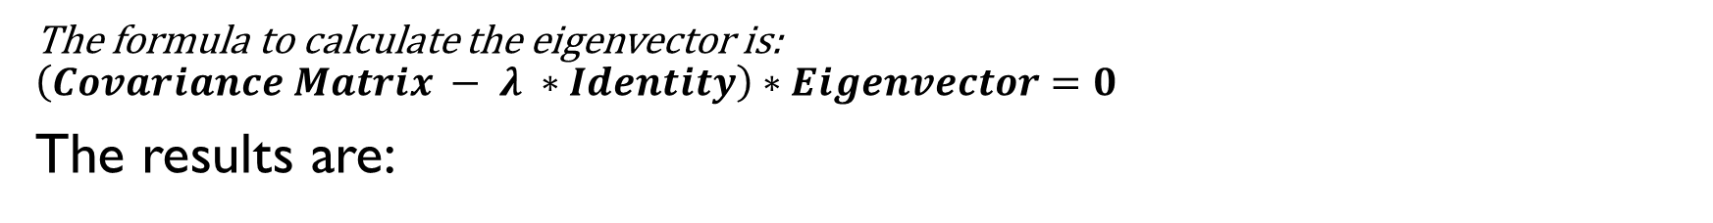

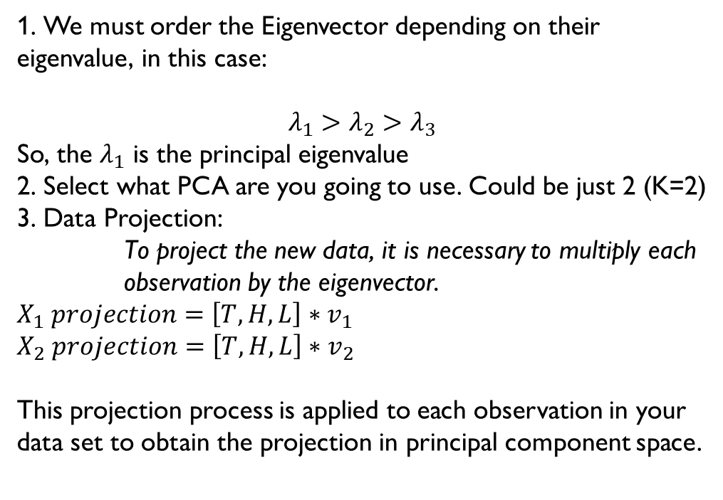
Calculate the Eigenvectors
The formula to calculate the eigenvector is:
$$\left(Covariance Matrix − λ ∗Identity\right)∗Eigenvector=0$$
The results are:
1. We must order the Eigenvector depending on their eigenvalue, in this case:
$$λ_{1}>λ_{2}>λ_{3}$$
So, the $λ_{1}$ is the principal eigenvalue
2. Select what PCA are you going to use. Could be just 2 (K=2)
3. Data Projection:
To project the new data, it is necessary to multiply each observation by the eigenvector.
$X_{1} projection=\left[T, H, L\right]∗v_{1}$
$X_{2} projection=\left[T, H, L\right]∗v_{2}$
This projection process is applied to each observation in your data set to obtain the projection in principal component space.
For $λ_{1}$the eigenvector is approximately:
$v_{1}= \left[\begin{matrix}0.096 \\ 0.046 \\ 0.995\end{matrix}\right]$
For $λ_{2}$the eigenvector is approximately:
$v_{2}= \left[\begin{matrix}0.141 \\ 0.989 \\ −0.44\end{matrix}\right]$
For $λ_{3}$the eigenvector is approximately:
$v_{3}= \left[\begin{matrix}0.986 \\ −0.137 \\ −0.092\end{matrix}\right]$

Slide 9
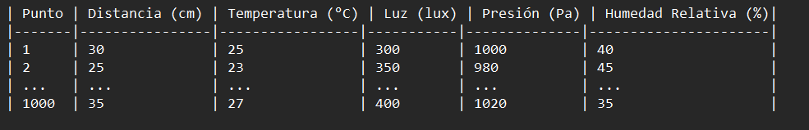
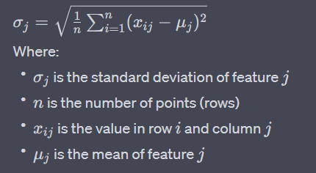
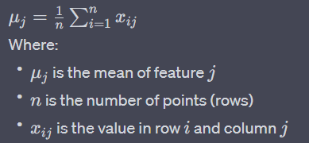

Example
Step 1: We have the following dataset
Step 2: Normalize de data
We must calculate the mean (average) for each feature:
Step 3: Calculate the standard deviation for each feature
1. We calculate the standard deviation for each feature
Notes:
Lets imagine we have a dataset with 1000 observations and 5 parameters. We need to calculate the mean of each column and its standard deviation, we’ll use it to normalize our data.

Slide 10
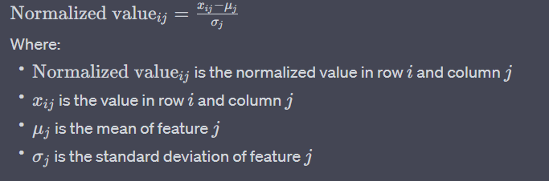
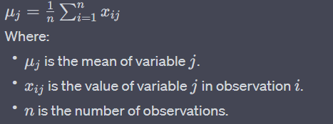

Example
Covariance matrix
Let's represent the matrix X with dimensions n (observations) x m (variables). The covariance matrix is calculated as follows:
Calculated the mean for each variable
Center the data
We subtract the mean of each variable form all the values of that variable in the dataset . This give us a Matrix Xcentered of the same dimension as X but with a mean of zero for each variable
Step 4: Data normalization
We use the calculate mean and standard deviation to normalize each value
Notes:
That means adjusting the values in each column so that they have a common scale or distribution, making it easier to compare and analyze. Then we calculate the covariance matrix. In order to do so we need to center our data using this equation.

Slide 11
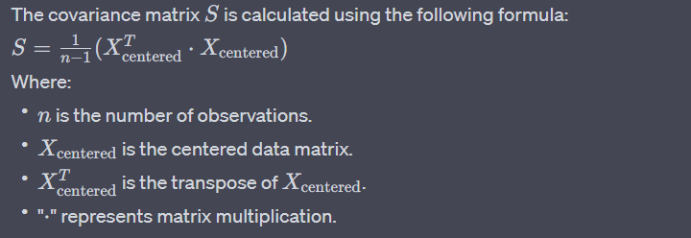
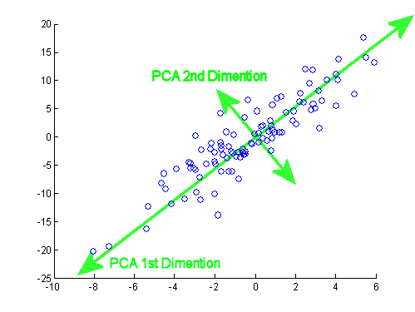
Example
Step 6: Calculated the covariance matrix
The covariance matrix S is calculated using the following formula:
The resulting matrix S is a symmetric matrix of dimensions m × m that contains the covariances between all combinations of variables.
Step 7: Select the principal components
Once we have calculated the covariance matrix and its corresponding eigenvectors and eigenvalues, the next step is to select the principal components. We sort the eigenvectors according to their corresponding eigenvalues in decreasing order.
Notes:
Once centered we obtain the covariance matrix and find our eigenvectors and eigenvalues, then we choose our principal components.

Slide 12
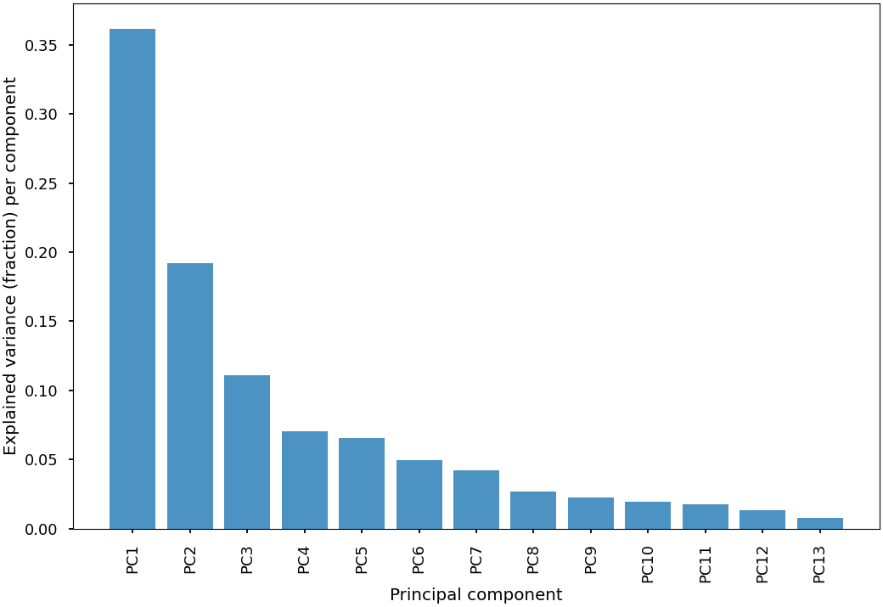
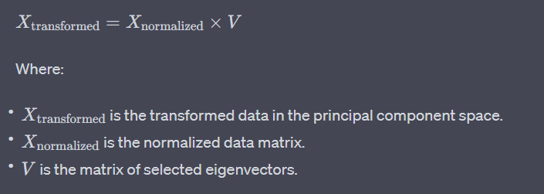

Example
Step 8: Data Transformation
2. Once we have selected the N eigenvectors, we multiply the normalized data matrix by these N eigenvectors to obtain the new representation of the data in the principal component space.
3. This new representation in the principal component space can be utilized for planning and navigation of the robot in the environment. By reducing the dimensionality of the data while retaining the relevant information for the robot's decisions,
Notes:
We can graph our new set by multiplying the eigenvectors times our observations and plotting it on a graph

